Slide 1

Geometry
Unit 7, Lesson 1 The Pythagorean Theorem Volume 1, pg. 369

Slide 2


Benchmarks
MA.912.T.1.1
Define trigonometric ratios for acute angles in right triangles.
MA.912.T.1.2
Solve mathematical and real-world problems involving right triangles using trigonometric ratios and the Pythagorean Theorem.
volume 1, pg. 369

Slide 3
Integrated Mathematical Thinking and Reasoning Standards
MA.K12.MTR.1.1 Actively participate in effortful learning both individually and collectively.
MA.K12.MTR.2.1 Demonstrate understanding by representing problems in multiple ways.
MA.K12.MTR.3.1 Complete tasks with mathematical fluency.
MA.K12.MTR.4.1 Engage in discussions that reflect on the mathematical thinking of self and others.
MA.K12.MTR.5.1 Use patterns and structure to help understand and connect mathematical concepts.
MA.K12.MTR.6.1 Assess the reasonableness of solutions.
MA.K12.MTR.7.1 Apply mathematics to real-world contexts.
volume 1, pg. 369

Slide 4

Learning Target
I can find the missing side of a right triangle using the Pythagorean Theorem.
volume 1, pg. 369

Slide 5

Warm-Up
volume 1, pg. 369

Slide 6
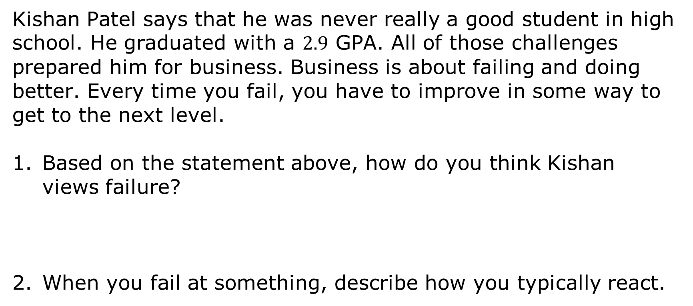
7.1.1 Warm-Up: Sales Strategist
Kishan Patel says that he was never really a good student in high school. He graduated with a $2.9$ GPA. All of those challenges prepared him for business. Business is about failing and doing better. Every time you fail, you have to improve in some way to get to the next level.
Based on the statement above, how do you think Kishan views failure?
When you fail at something, describe how you typically react.
volume 1, pg. 369

Slide 7

Collaboration
volume 1, pg. 370

Slide 8

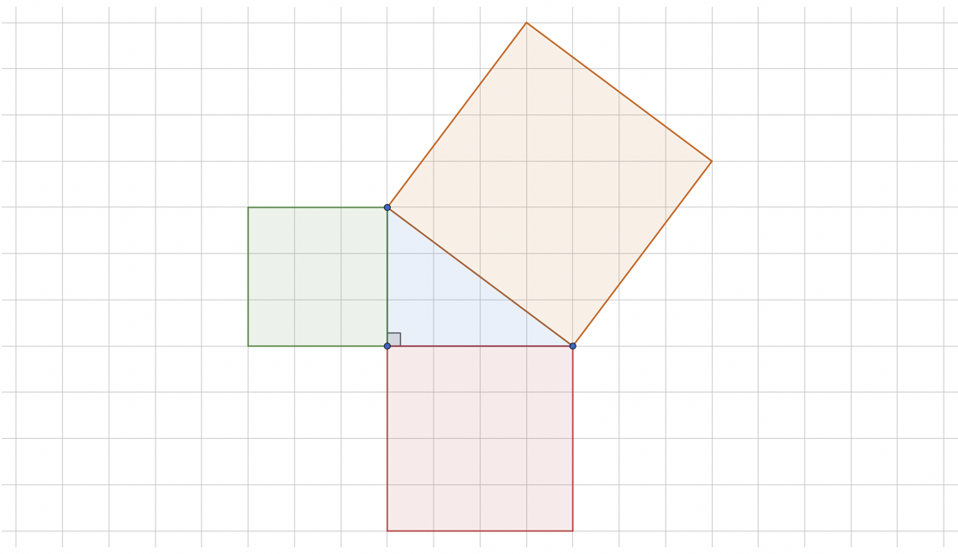
7.1.2 Collaboration: Pythagorean Theorem
A right triangle is shown with three squares.
volume 1, pg. 370

Slide 9
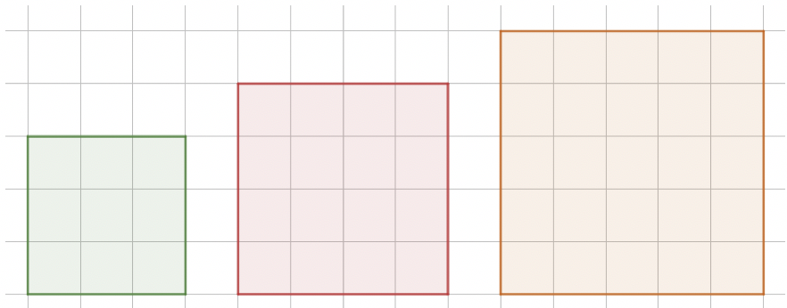
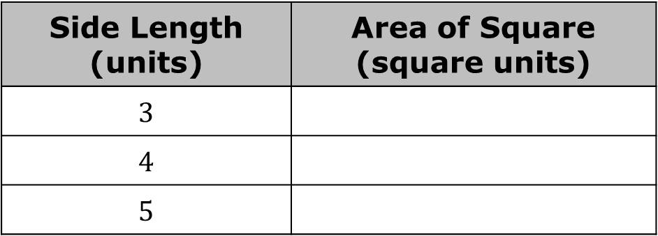
The three squares from the diagram are shown. Complete the table with the area of each square.
Side Length (units) | Area of Square (square units)
$$3$$
$$4$$
$$5$$
volume 1, pg. 370

Slide 10
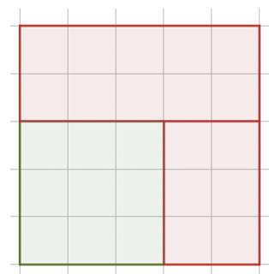
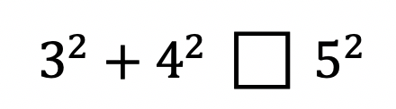
Explain how the diagram shows that the area of the green square plus the area of the red square is equal to the area of the orange square.
Complete the relationship of the areas by filling in the box.
volume 1, pg. 370

Slide 11
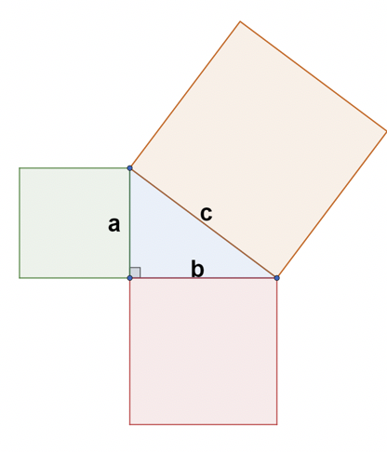
Use the diagram to write an explanation of the Pythagorean Theorem, $a^{2}+b^{2}=c^{2}$.
volume 1, pg. 370

Slide 12
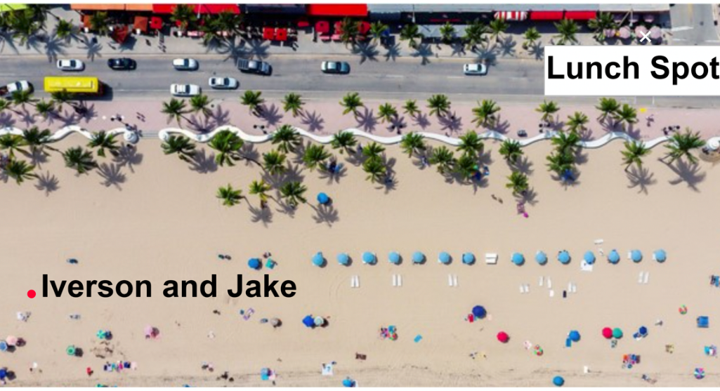
Iverson and Jake are at the beach and plan to meet a friend for lunch.
volume 1, pg. 371

Slide 13
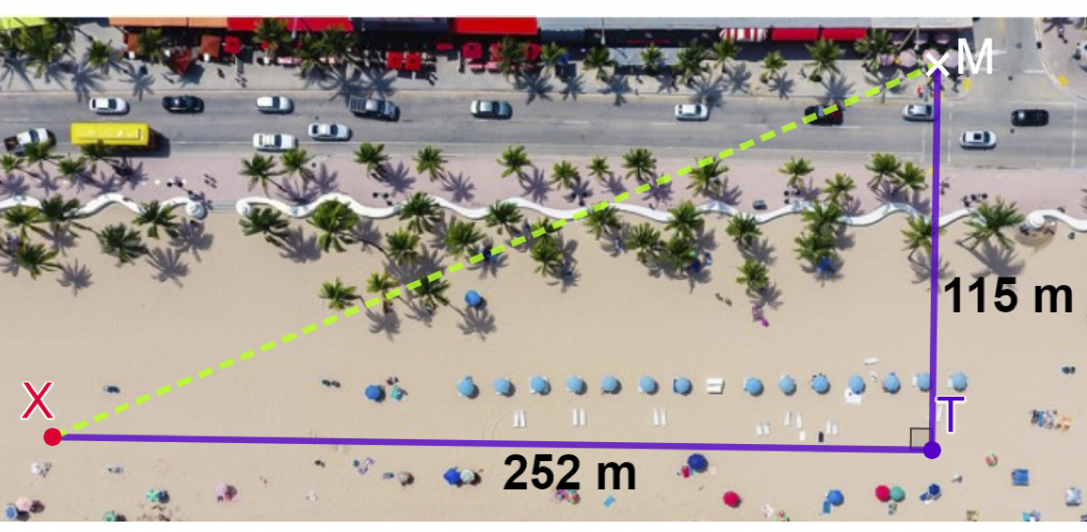
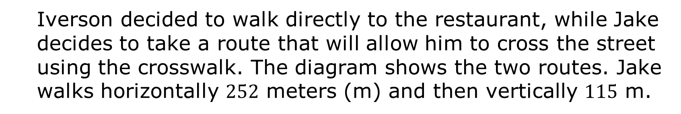
Iverson decided to walk directly to the restaurant, while Jake decides to take a route that will allow him to cross the street using the crosswalk. The diagram shows the two routes. Jake walks horizontally $252$ meters (m) and then vertically $115$ m.
volume 1, pg. 371

Slide 14
Complete the table.
Discuss with your partner the advantages and disadvantages of each person’s walk to the restaurant. Summarize your discussion in the table.
 | Iverson | Jake
Distance Walked
Person | Advantages | Disadvantages
Iverson
Jake
volume 1, pg. 371

Slide 15
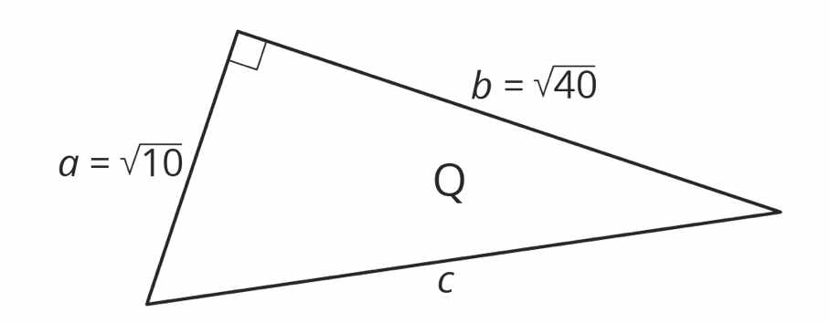


A right triangle is shown with side lengths $\sqrt{10}$ and $\sqrt{40}$ units.
Find the length of the hypotenuse using the Pythagorean Theorem. If the measure of the side length is an irrational value, write an exact solution and an approximate solution.
State Pythagorean Theorem
Substitute
$$a^{2}+b^{2}=c^{2}$$
$${______}^{2}+{______}^{2}=c^{2}$$
volume 1, pg. 372

Slide 16
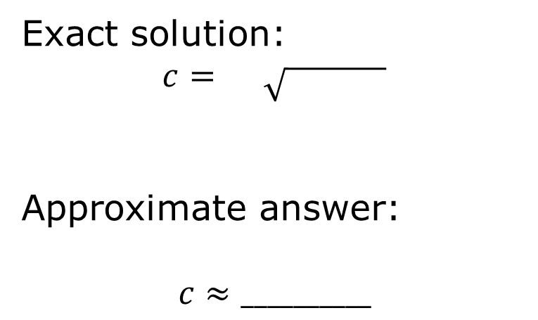

$______+______=c^{2}$
$$______=c^{2}$$
Solve for the missing variable.
Solutions
Exact solution:
$$c= \sqrt{ }$$
Approximate answer:
$$c≈__________$$
volume 1, pg. 372

Slide 17

Guided Practice
volume 1, pg. 372

Slide 18

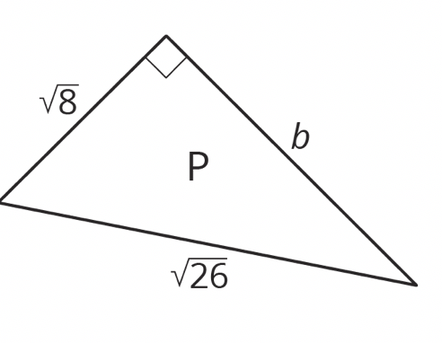
7.1.3 Guided Practice: Pythagorean Theorem
Find the exact measure of $b$ in the diagram.
volume 1, pg. 372

Slide 19
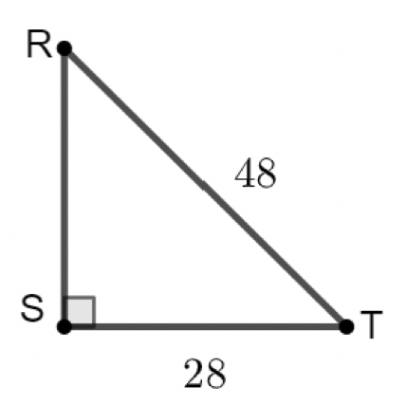

$ΔRST$ is shown, where $ST=28$ and $RT=48$.
Find the length of $\overline{SR}$ to the nearest thousandth.
volume 1, pg. 372

Slide 20
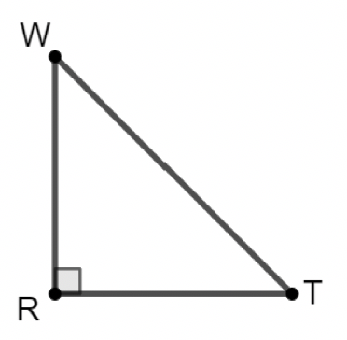

$ΔWRT$ is shown, where $WT=18.4$ and $RT=12.1$.
Find the length, to the nearest thousandth, of $\overline{WR}$.
volume 1, pg. 373

Slide 21

Your Turn
volume 1, pg. 373

Slide 22
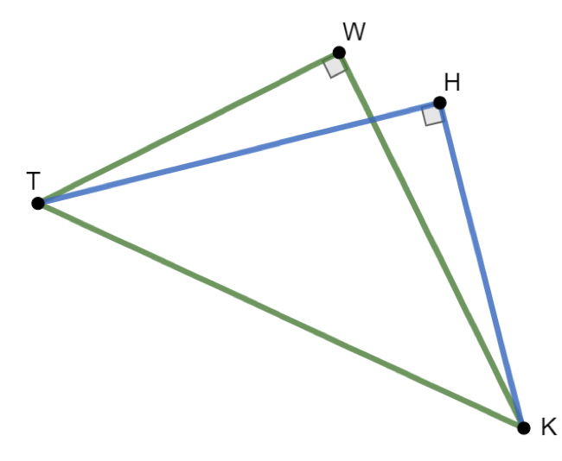
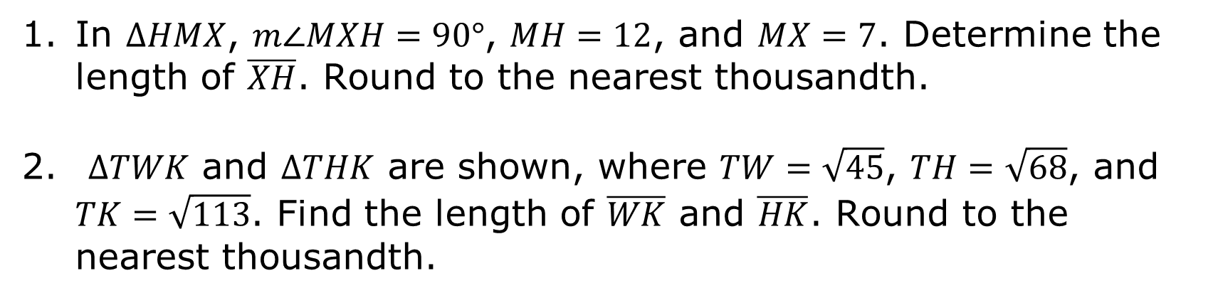
7.1.4 Your Turn!
In $ΔHMX$, $m∠MXH=90°$, $MH=12$, and $MX=7$. Determine the length of $\overline{XH}$. Round to the nearest thousandth.
$ΔTWK$ and $ΔTHK$ are shown, where $TW=\sqrt{45}$, $TH=\sqrt{68}$, and $TK=\sqrt{113}$. Find the length of $\overline{WK}$ and $\overline{HK}$. Round to the nearest thousandth.
volume 1, pg. 373

Slide 23

Wrap-Up
volume 1, pg. 374

Slide 24
7.1.5 Wrap-Up: Cool Down
Write an explanation to a classmate who might have missed today’s lesson, in your own words, about the Pythagorean Theorem.
volume 1, pg. 374

